Slide 1
Desktop Publishing
Bi-Weekly Photo Project
By: Vincent Borrelli

Slide 2


Background and Foreground
Rule of Thirds

Slide 3

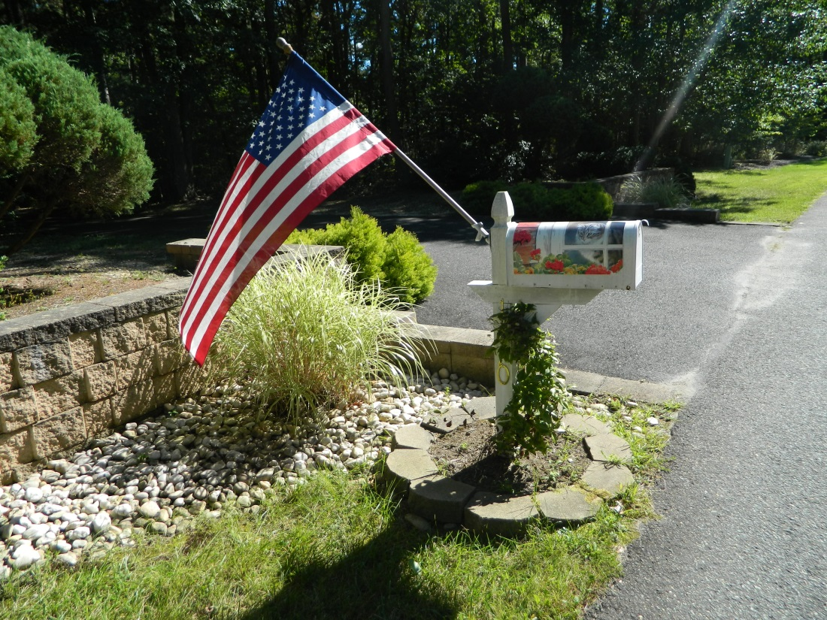
Background and Foreground
Balancing Elements

Slide 4

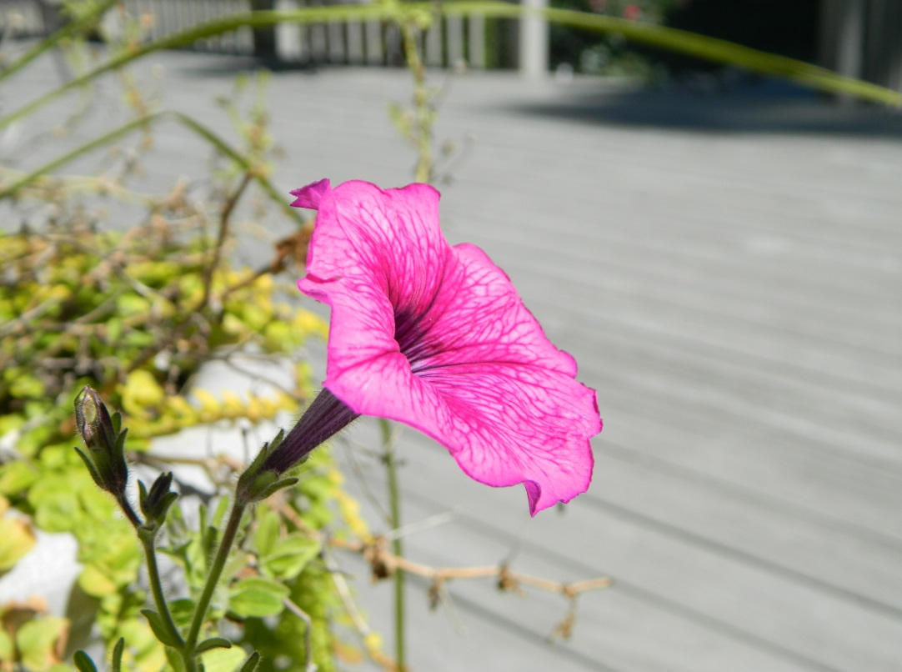
View point
Focus

Slide 5
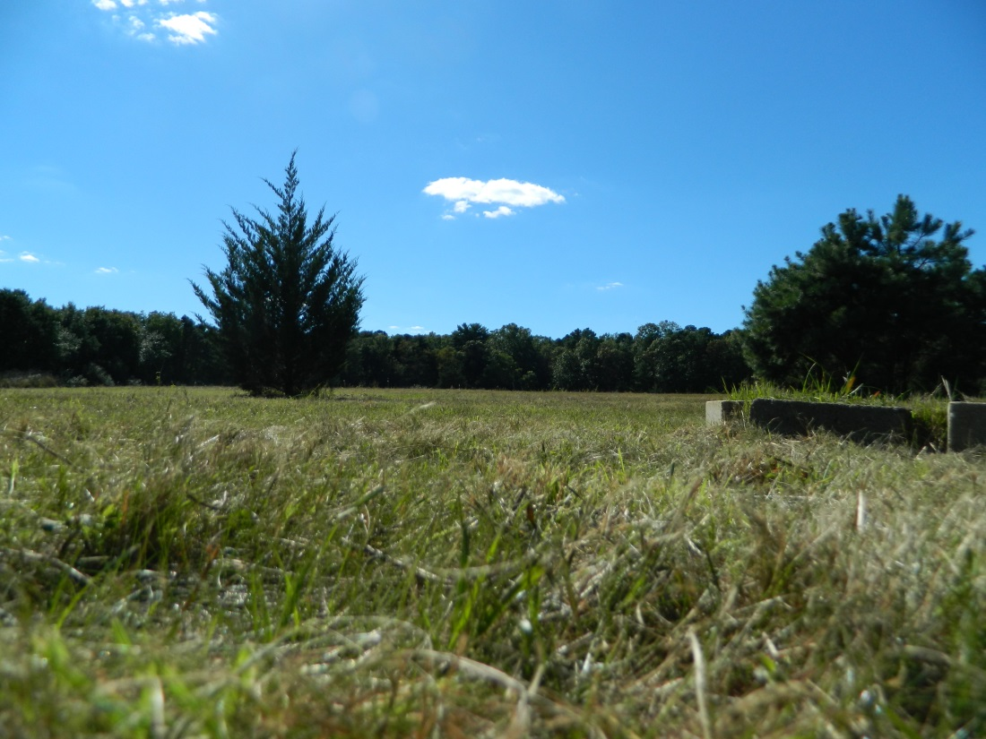
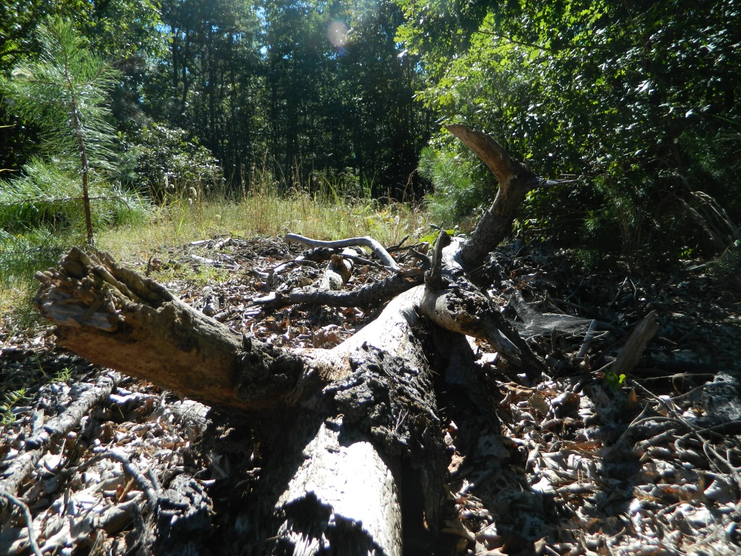
Background and Foreground
Focus

Slide 6
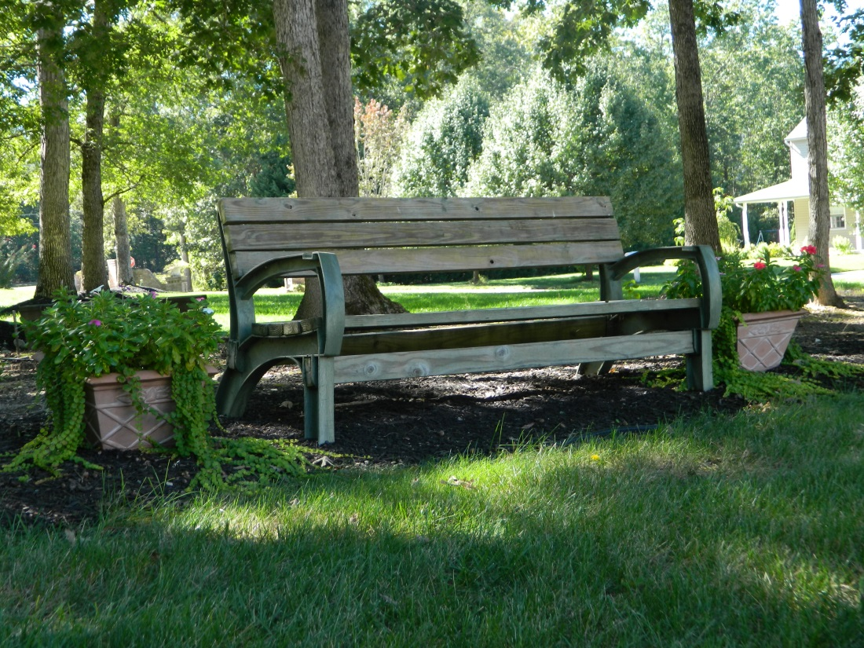
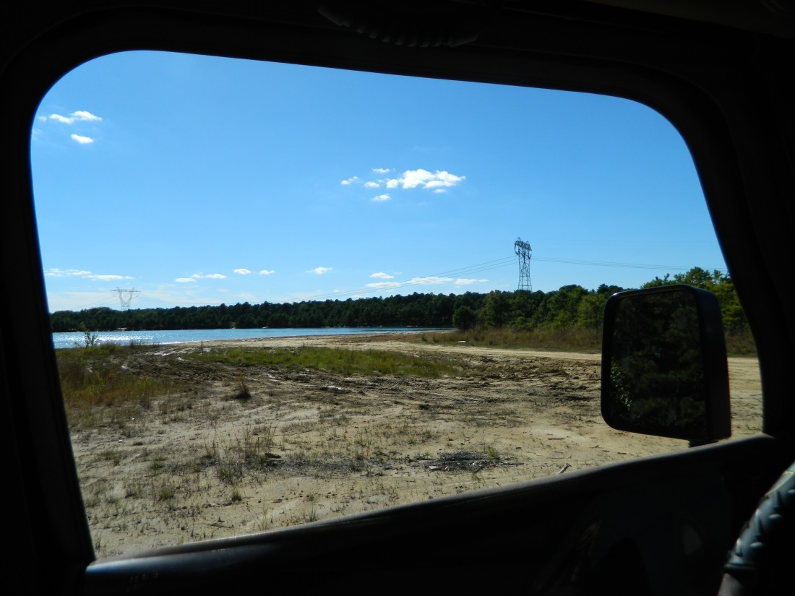
Symmetry
Framing

Slide 7
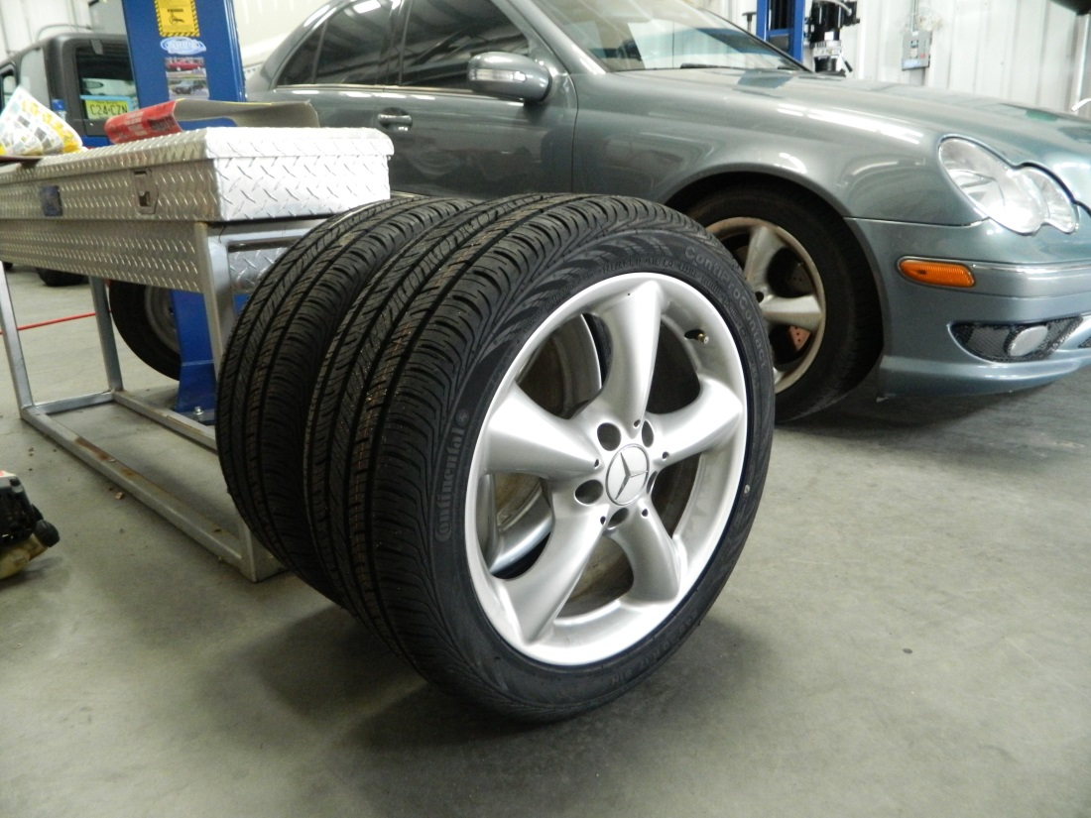
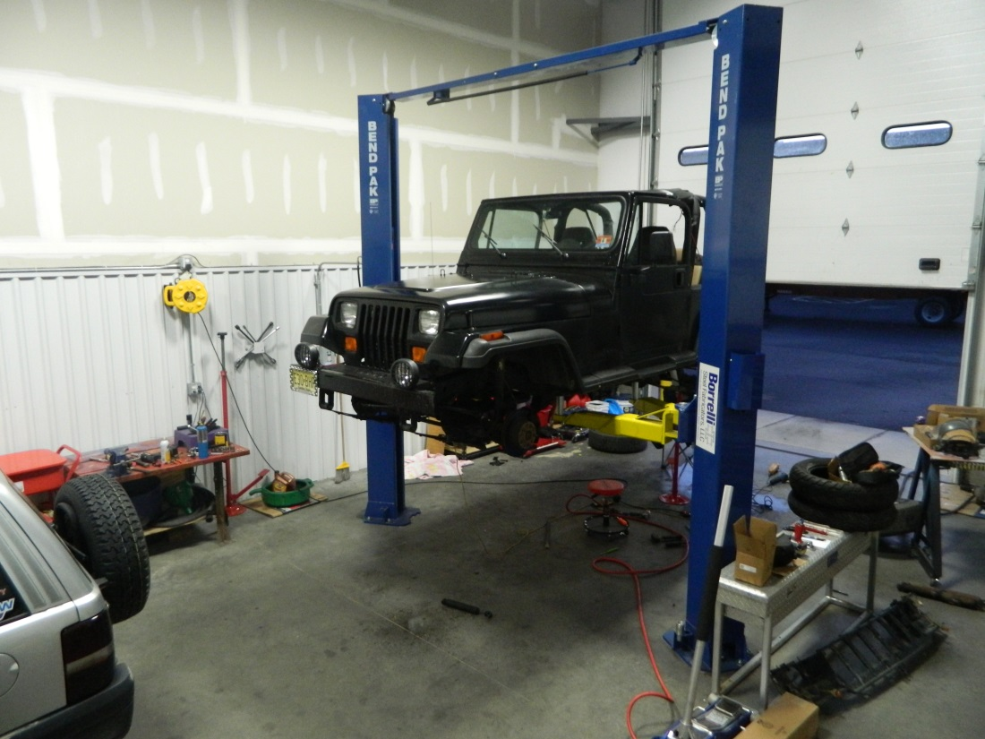
Focus
Viewpoint

Slide 8
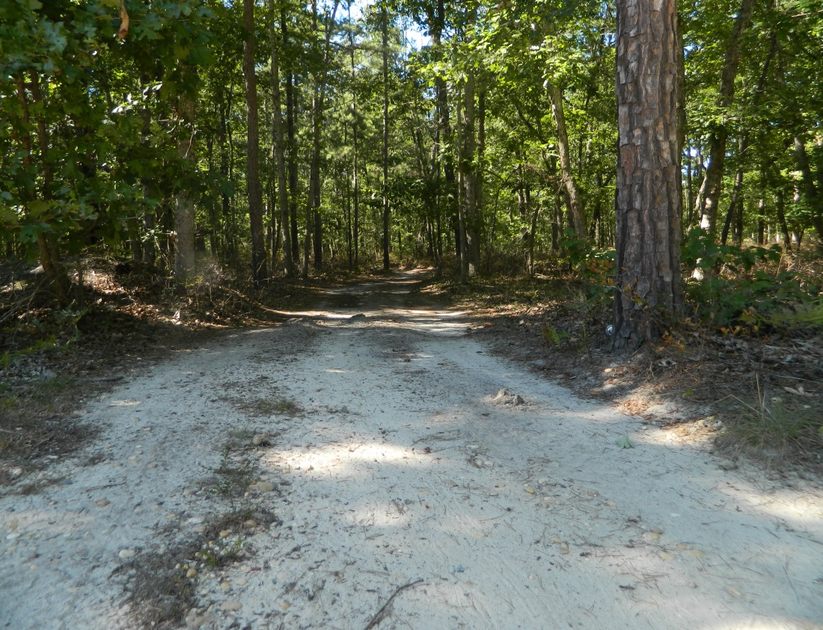
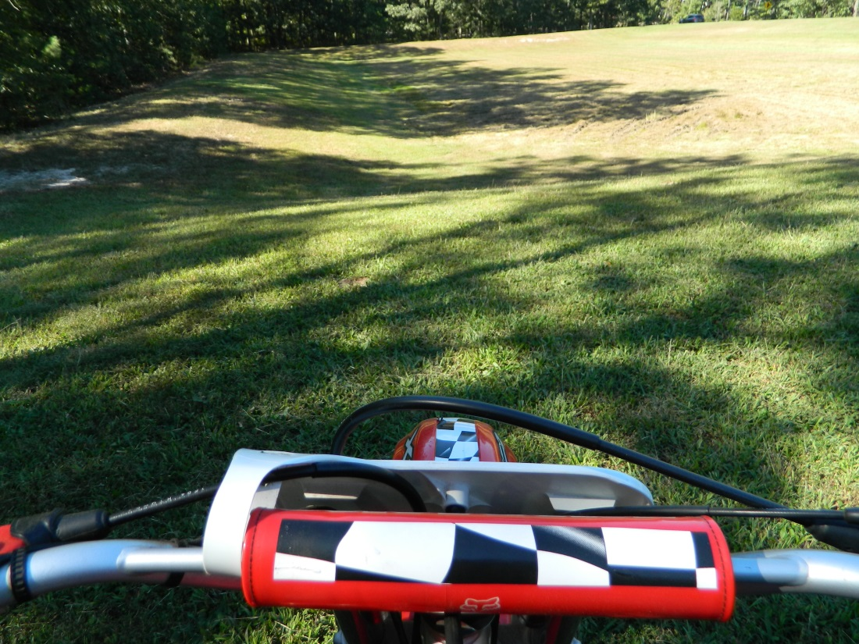
Depth
Viewpoint

Slide 9


Focus
Viewpoint

Slide 10
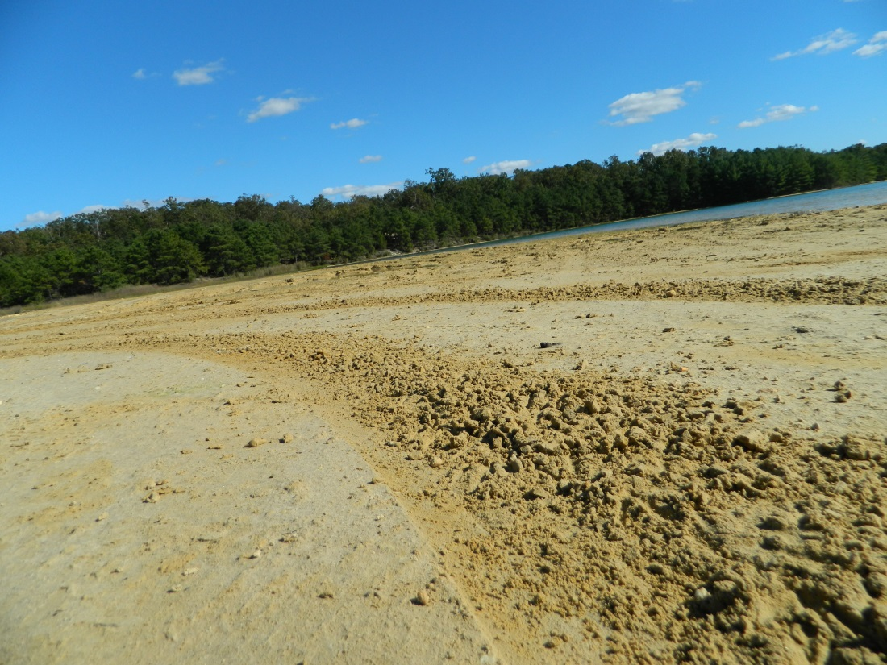

Focus
Viewpoint

Slide 11


Background and Foreground
Balancing Elements

